Slide 2
Research Update
Luke Kersting

Slide 3
Outline
Attraction Repulsion Model Review
Flow Chart
Possible Problems
  Dose
  Objective Function
  Displacement Vector
  Gain

Slide 4
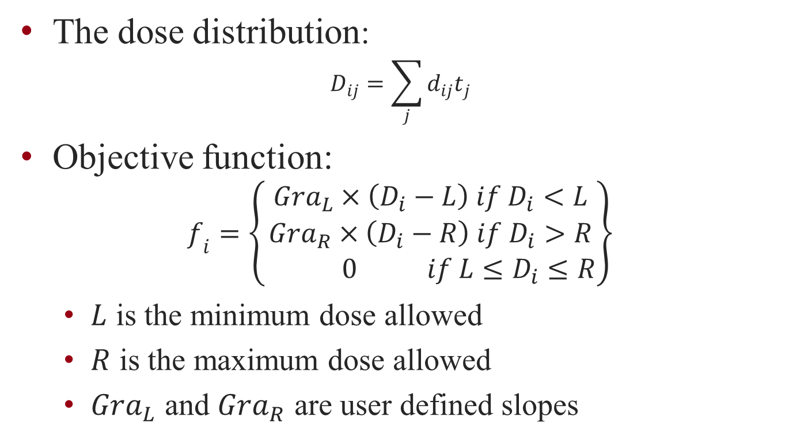
Dose and Objective Function

Slide 5

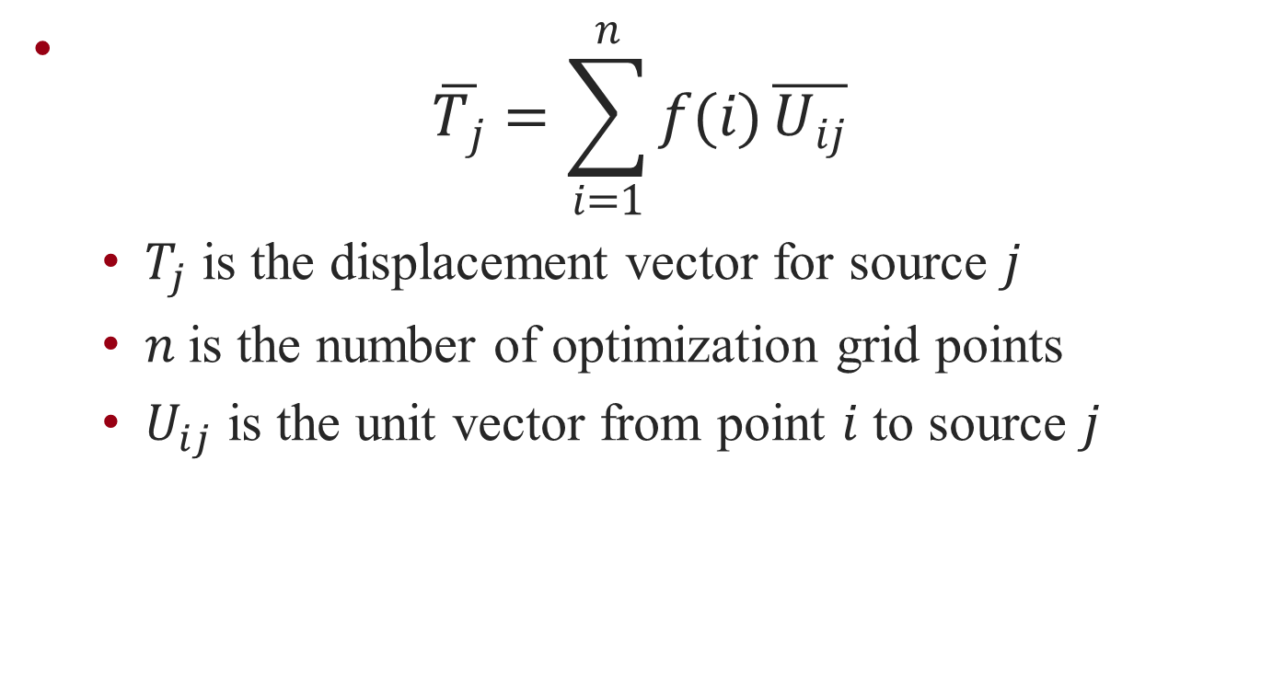

Slide 6
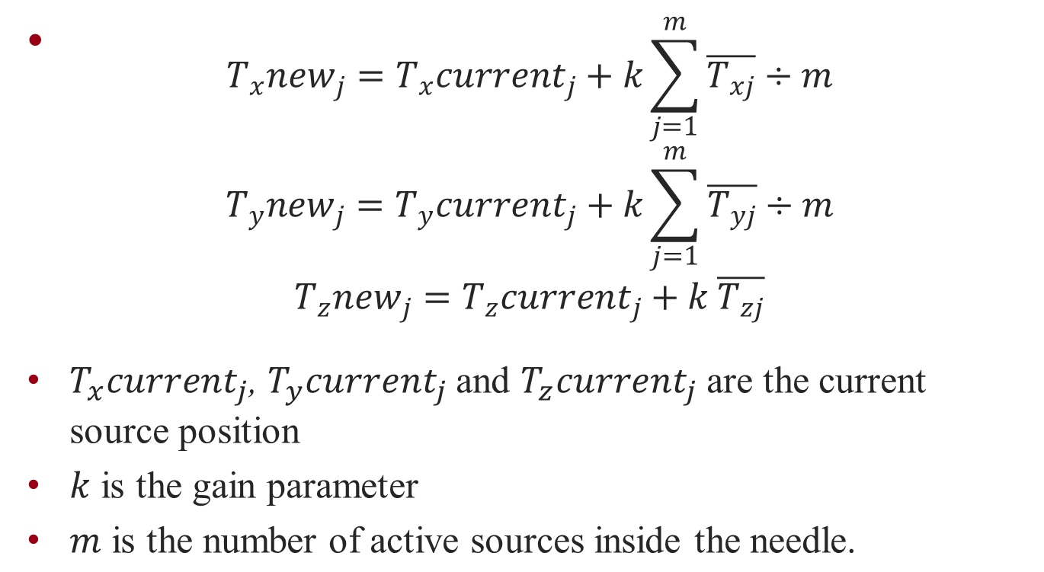
New Seed Position

Slide 7
Test Case
14 needles randomly placed.
Seeds are spaced out along the needles ever 5 mm
Seeds are active inside the prostate contours and inactive outside the prostate contours
Dose prescription was set to 145 Gy

Slide 8
Test Parameters
Dose potential parameters of target and critical organs
 | GRA_L | L | GRA_R | R
Target | -40 | 180 | -8 | 255
Urethra | -40 | 95 | -40 | 100
Rectum | 0 | --- | -40 | 80
Normal Tissue | 0 | --- | -40 | 145
Prescribed Dose: 145 Gy.

Slide 9
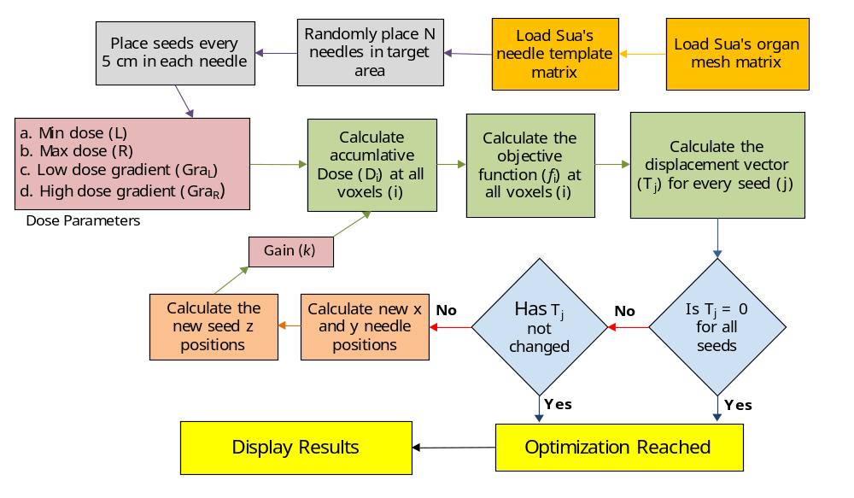
Flow Chart

Slide 10
Possible Problems
All seeds are pushed out of ROI
Dose
  High dose at small distance
  Different from Sua’s dose
Objective function
  Very high at point of seed
  Possibly bad parameters
Displacement Vector
Gain
  Not decreased after every iteration

Slide 11
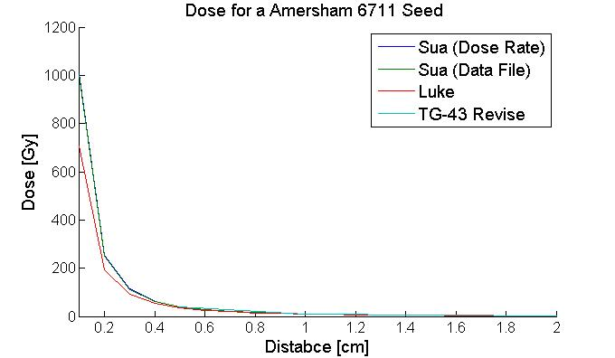
Comparison of Dose

Slide 12
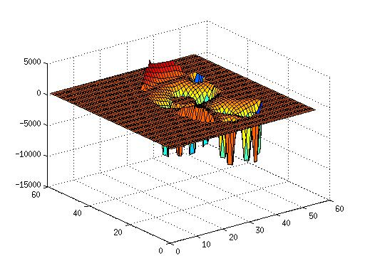
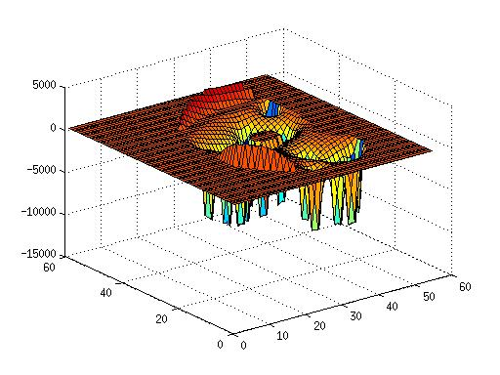
Objective Function
Slice 3
Slice 5

Slide 13
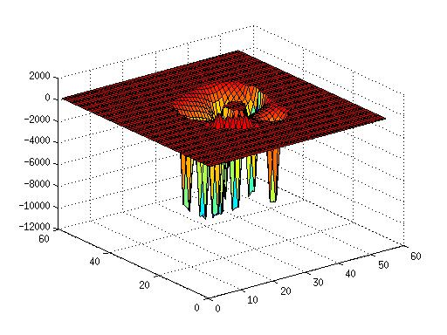
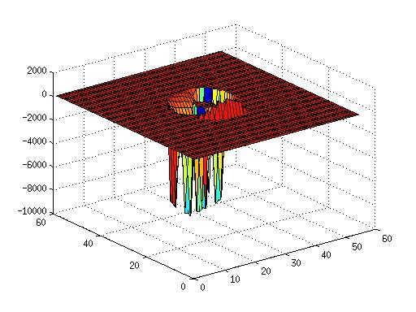
Objective Function
Slice 7
Slice 9

